Slide 2
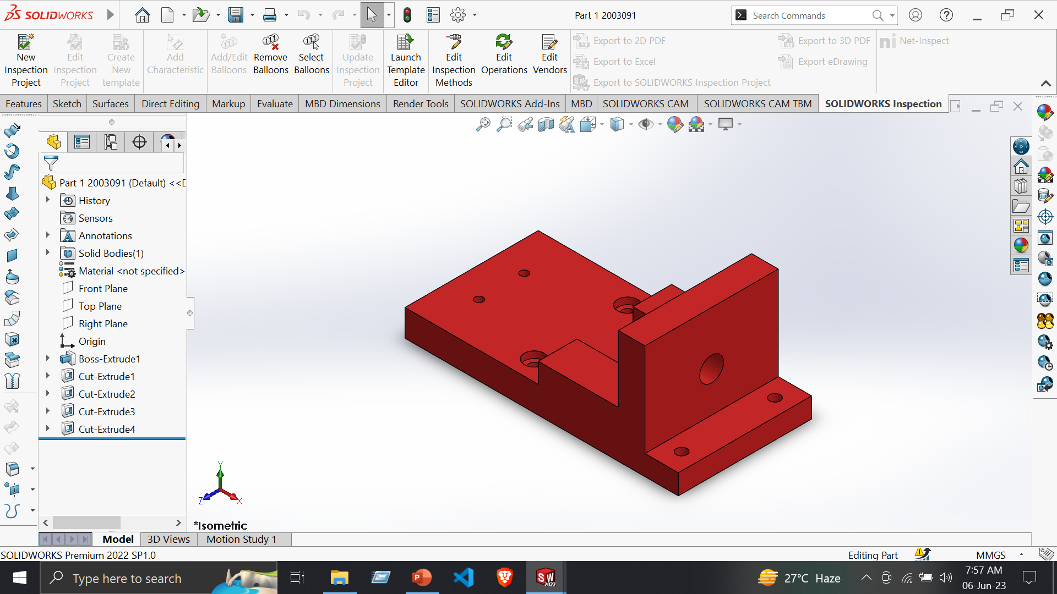
Part 1
Tools:
Line
Centerline
Circle
Smart Dimensions
Trim Entities
Features:
Extruded Boss/Base
Extruded Cut

Slide 3
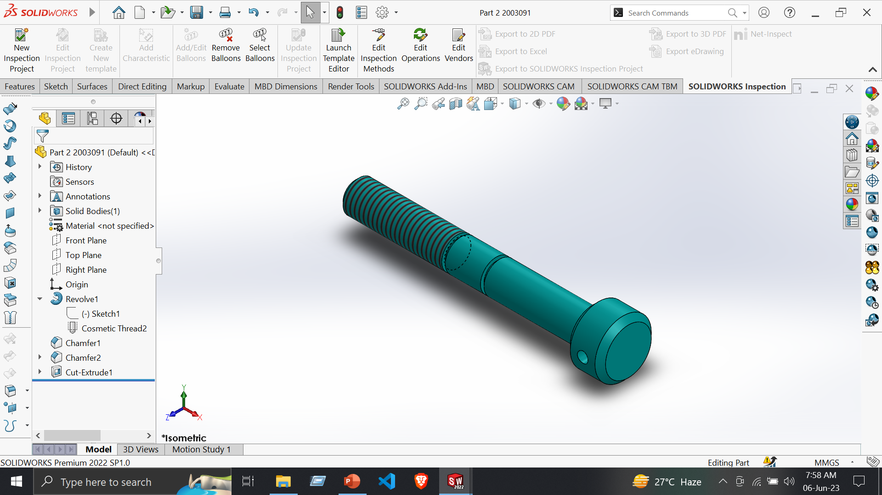
Part 2
Tools:
Line
Centerline
Circle
Smart Dimensions
Features:
Extruded Boss/Base
Extruded Cut
Chamfer

Slide 4
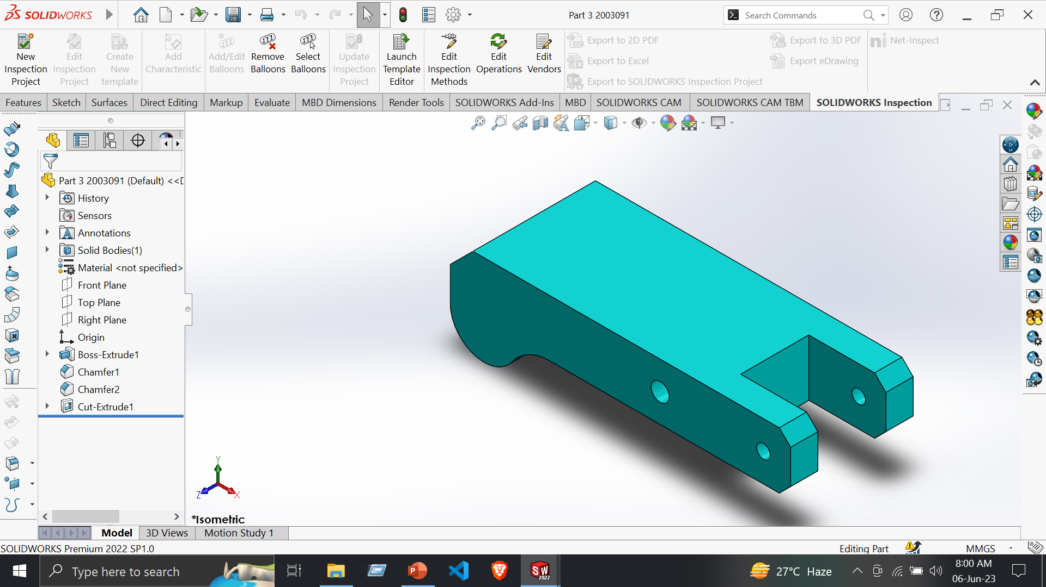
Part 3
Tools:
Line
Centerline
Circle
Smart Dimensions
Trim Entities
Features:
Extruded Boss/Base
Extruded Cut
Chamfer

Slide 5
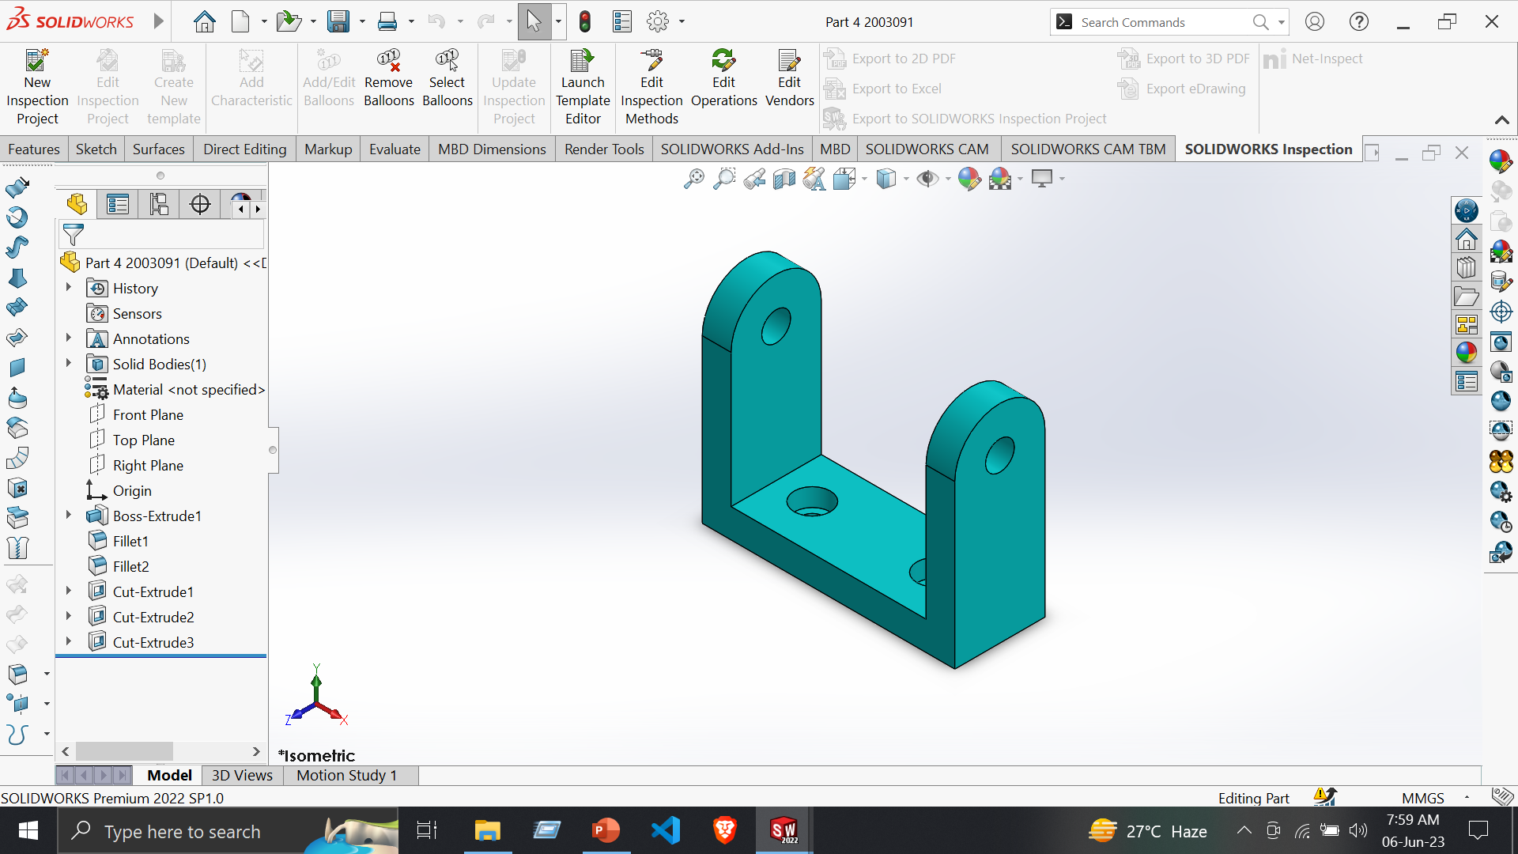
Part 4
Tools:
Line
Centerline
Circle
Smart Dimensions
Features:
Extruded Boss/Base
Extruded Cut
Fillet

Slide 6
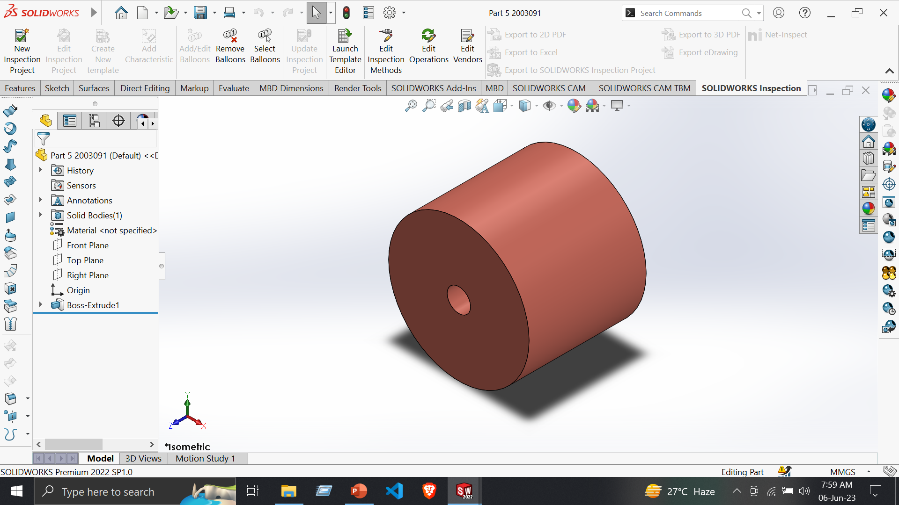
Part 5
Tools:
Centerline
Circle
Smart Dimensions
Features:
Extruded Boss/Base

Slide 7
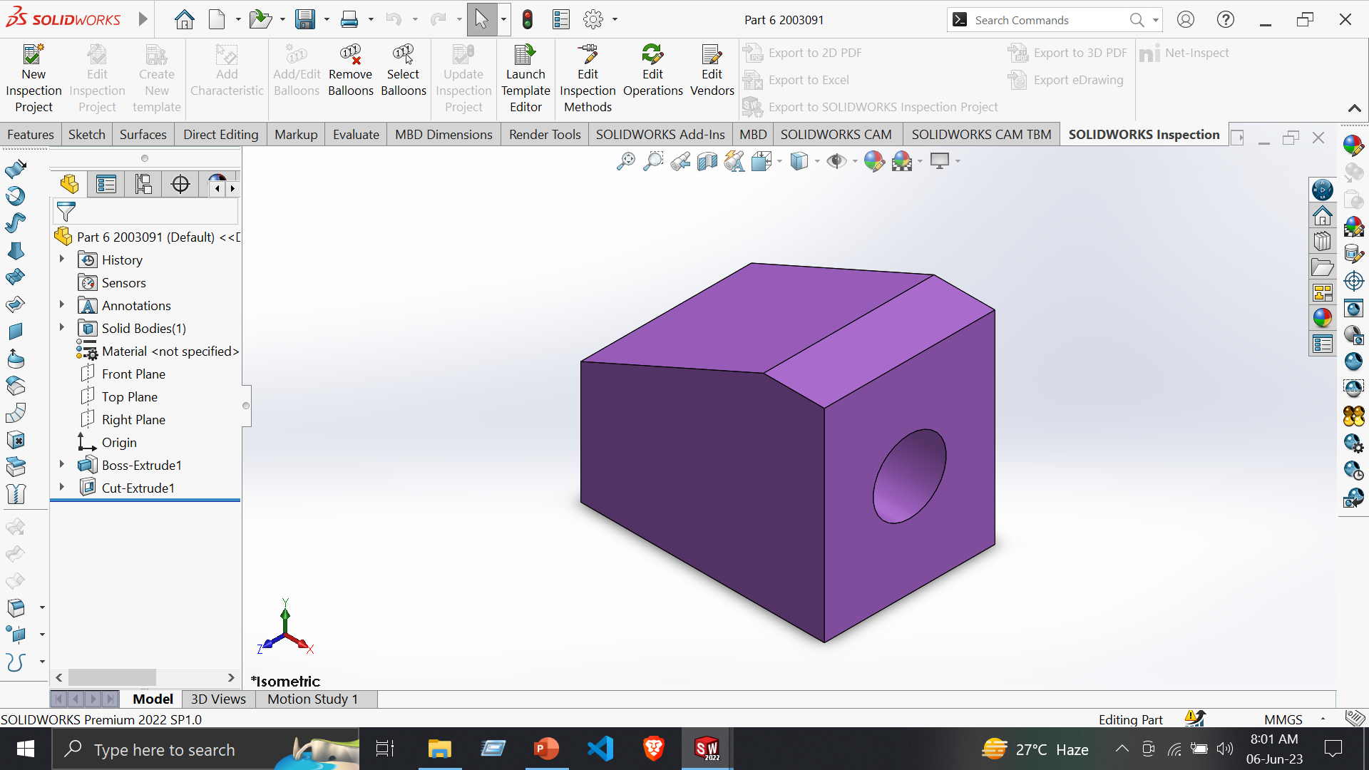
Part 6
Tools:
Line
Circle
Smart Dimensions
Features:
Extruded Boss/Base
Extruded Cut

Slide 8
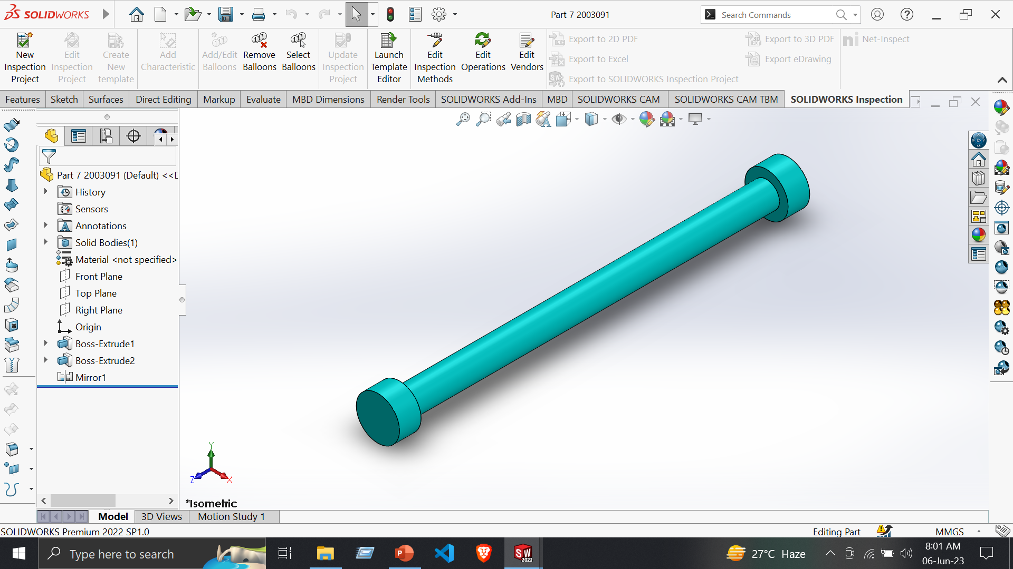
Part 7
Tools:
Line
Centerline
Circle
Smart Dimensions
Features:
Extruded Boss/Base

Slide 9
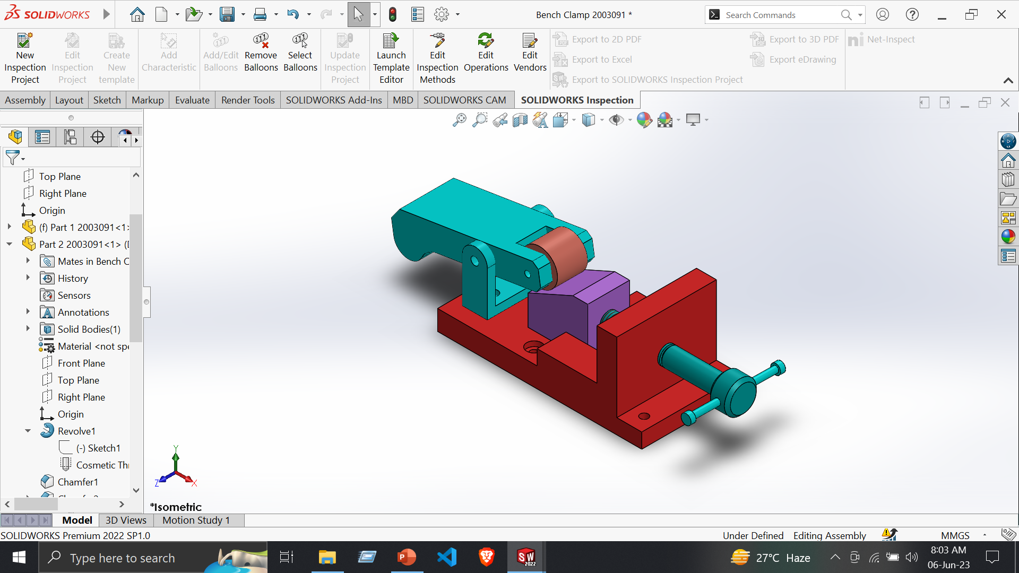
Assembly: Bench Clamp
Assembly –
Insert Component
Coincide Mate
Mechanical mate -> Screw
Advanced Mate -> Width
Concentric Mate

Slide 10
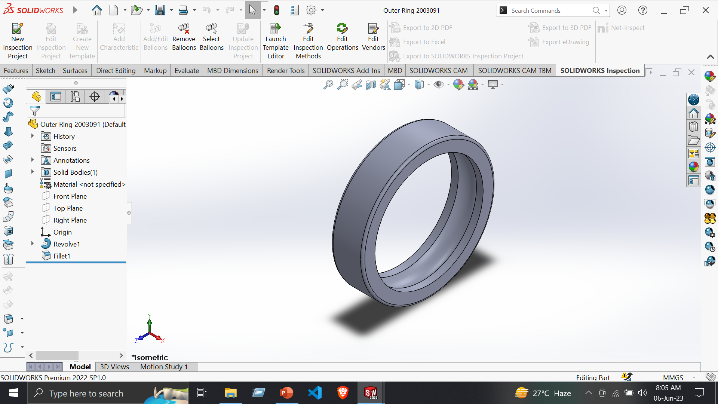
Part 1 - Outer Ring
Tools:
Line
Centerline
Smart Dimensions
Features:
Revolved Boss/Base
Fillet

Slide 11
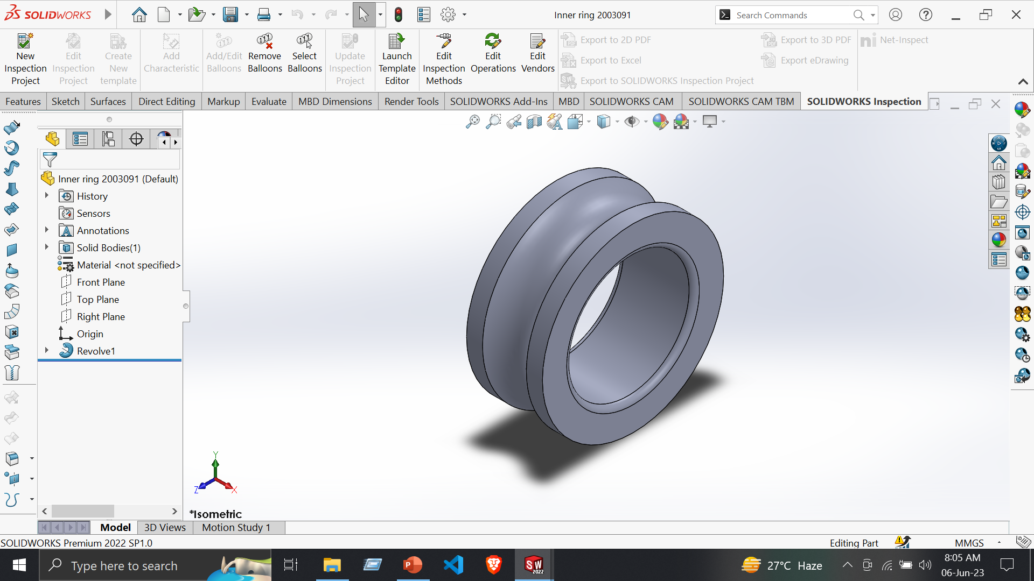
Part 2 - Inner Ring
Tools:
Line
Centerline
Smart Dimensions
Features:
Revolved Boss/Base

Slide 12
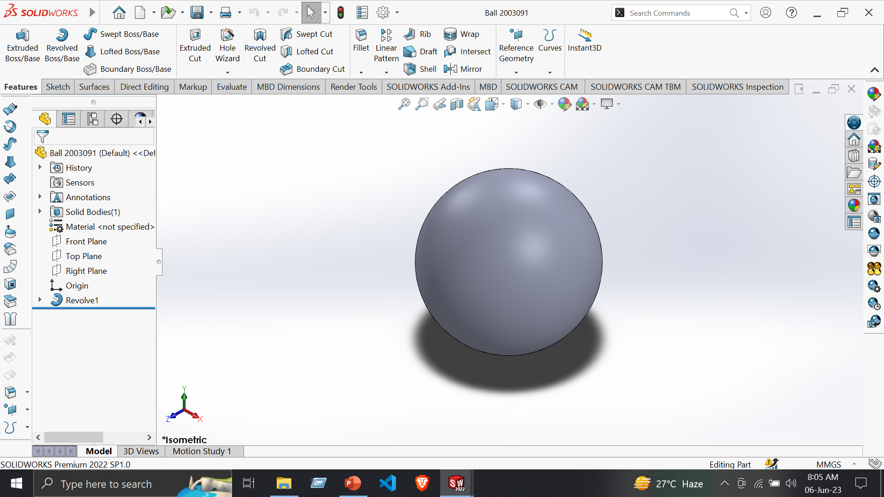
Part 3 - Ball
Tools:
Line
Centerline
Smart Dimensions
Features:
Revolved Boss/Base

Slide 13
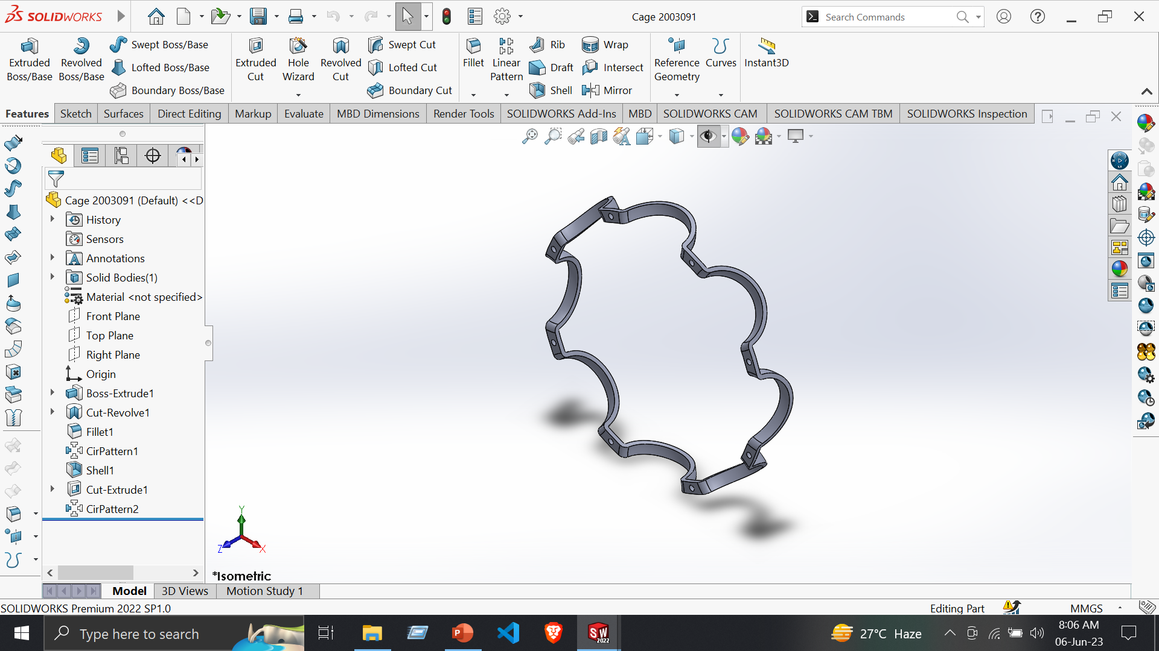
Part 4 - Cage
Tools:
Line
Centerline
Smart Dimensions
Features:
Extruded Boss/Base
Extruded Cut
Circular Pattern

Slide 14
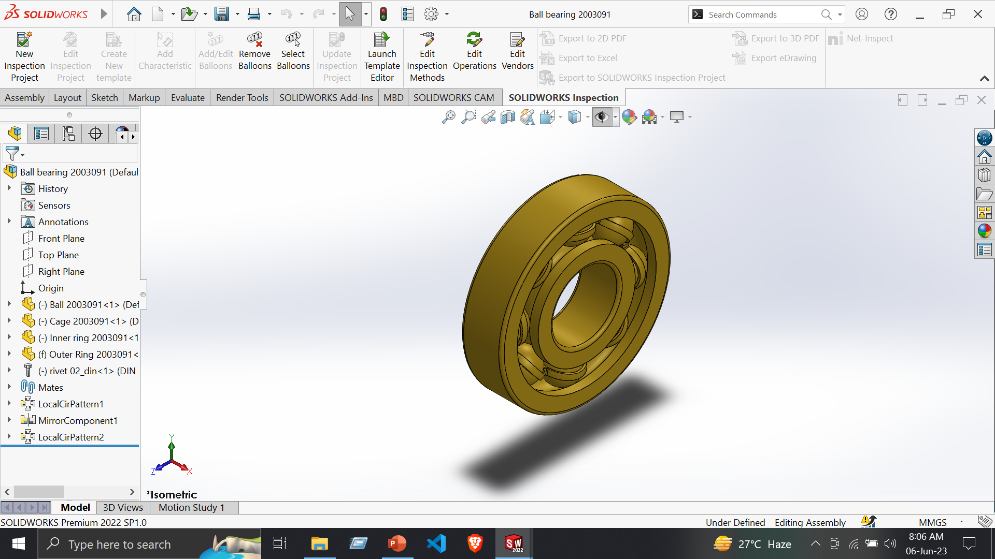
Assembly : Ball Bearing
Assembly –
Insert Component
Coincide Mate
Concentric Mate
Mirror Components

Slide 15
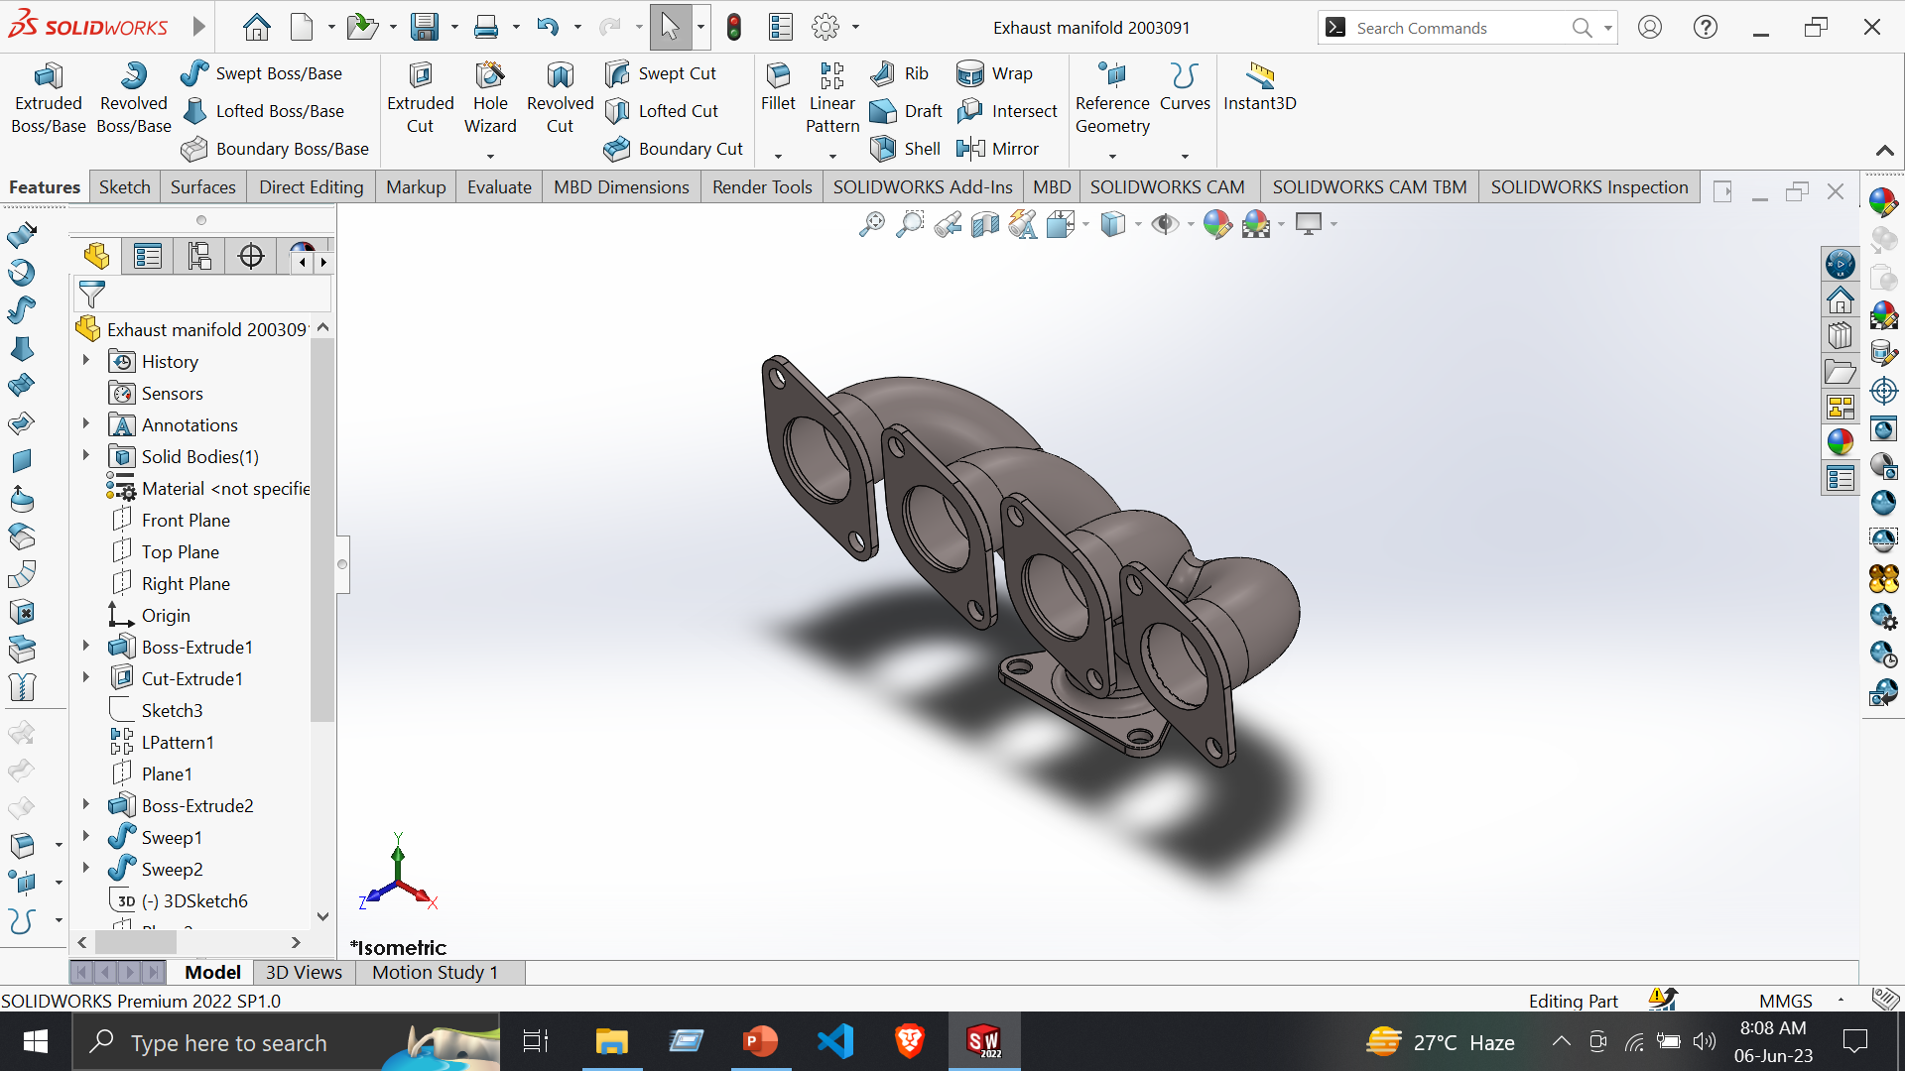
Part : Exhaust Manifold
Tools:
Line
Centerline
Circle
3d Sketch
Fillet
Trim Entities
Smart Dimensions
Features:
Extruded Boss/Base
Extruded Cut
Fillet
Swept Boss/Base
Shell

Slide 16
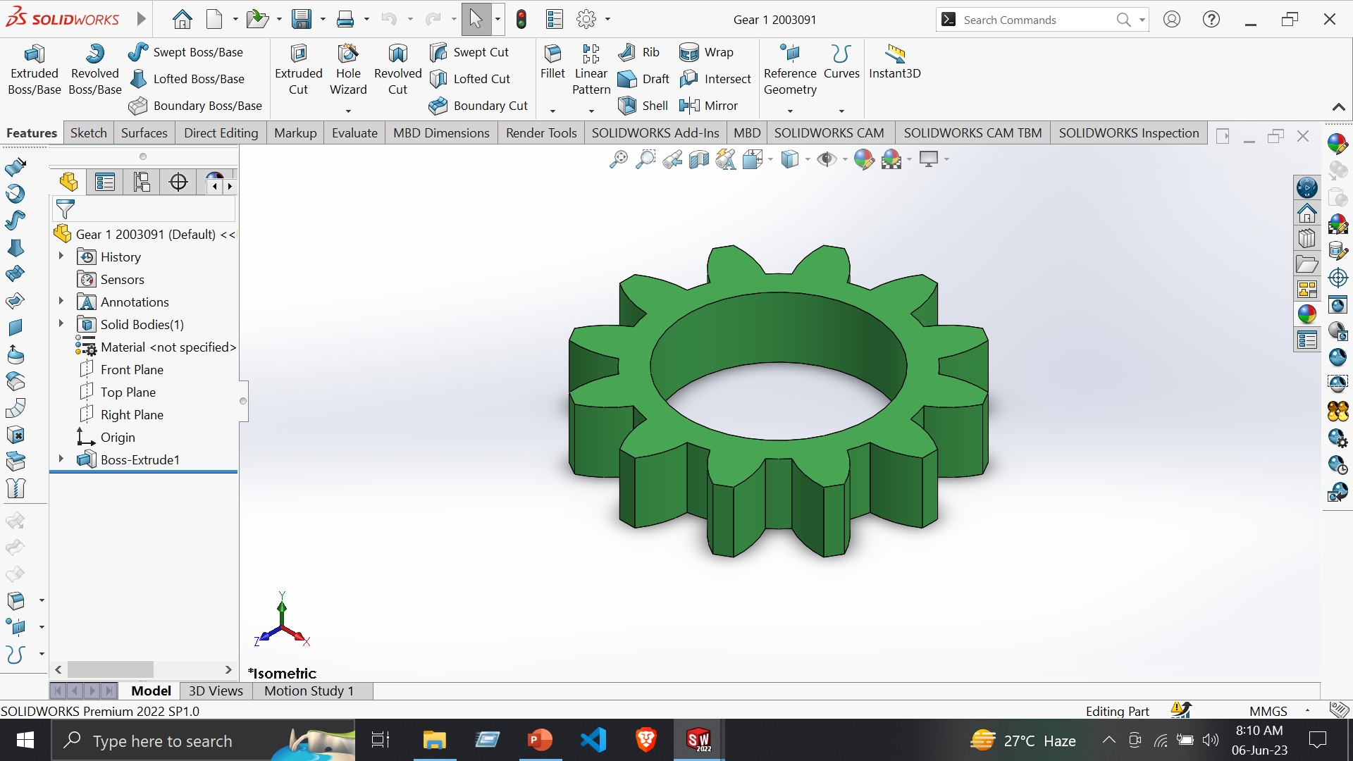
Part 1: Gear 1
Tools:
Line
Centerline
Circle
Trim Entities
Smart Dimensions
Features:
Extruded Boss/Base
Circular Pattern

Slide 17
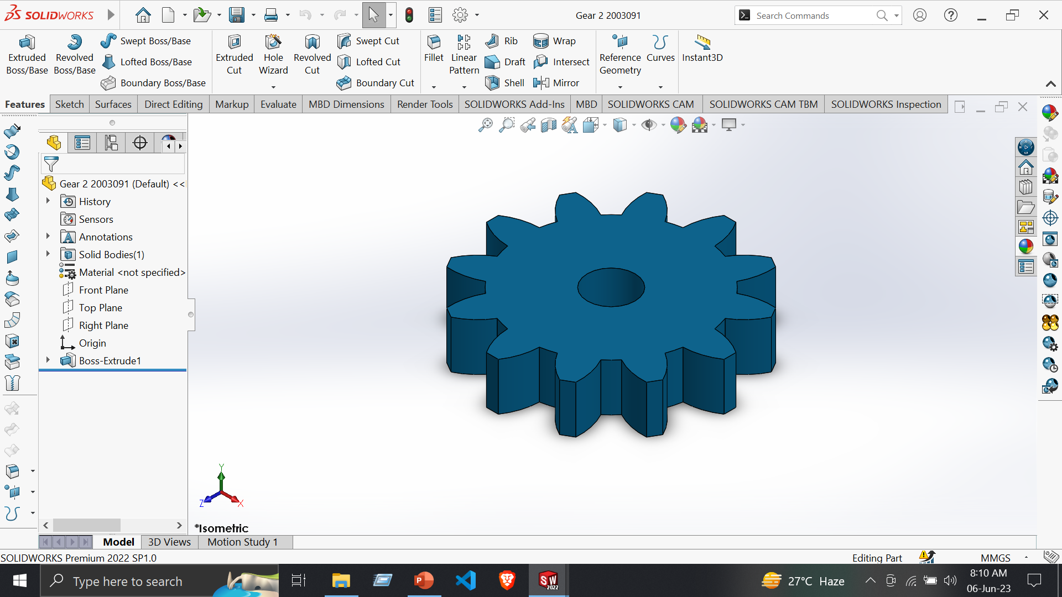
Part 2: Gear 2
Tools:
Line
Centerline
Circle
Trim Entities
Smart Dimensions
Features:
Extruded Boss/Base
Circular Pattern

Slide 18
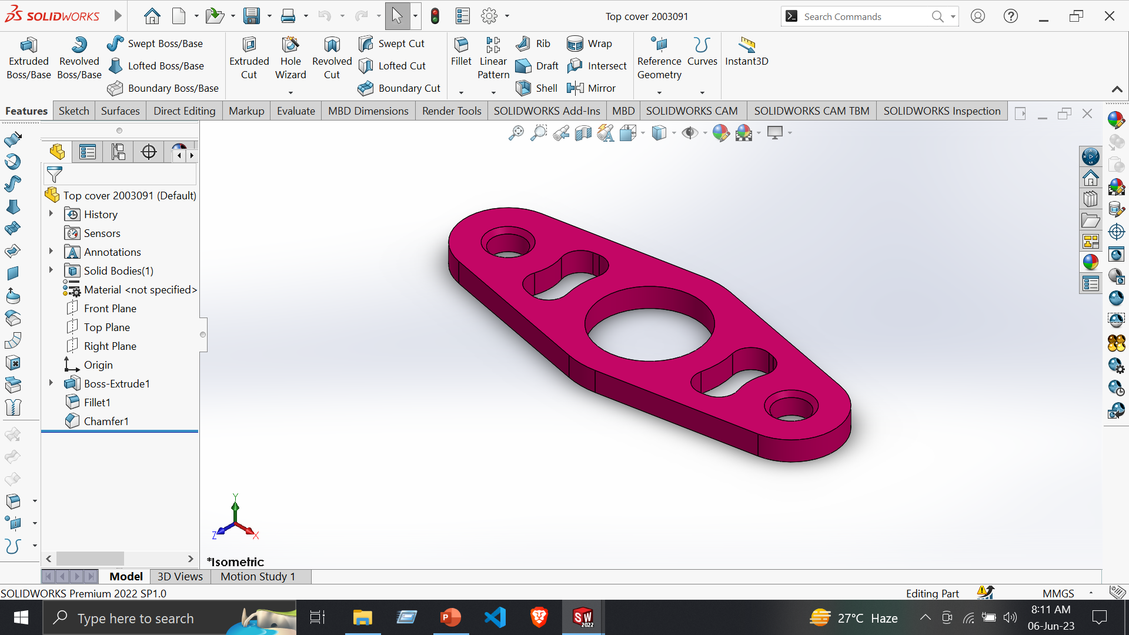
Part 3 : Top Cover
Tools:
Line
Centerline
Circle
Trim Entities
Smart Dimensions
Features:
Extruded Boss/Base
Chamfer

Slide 19
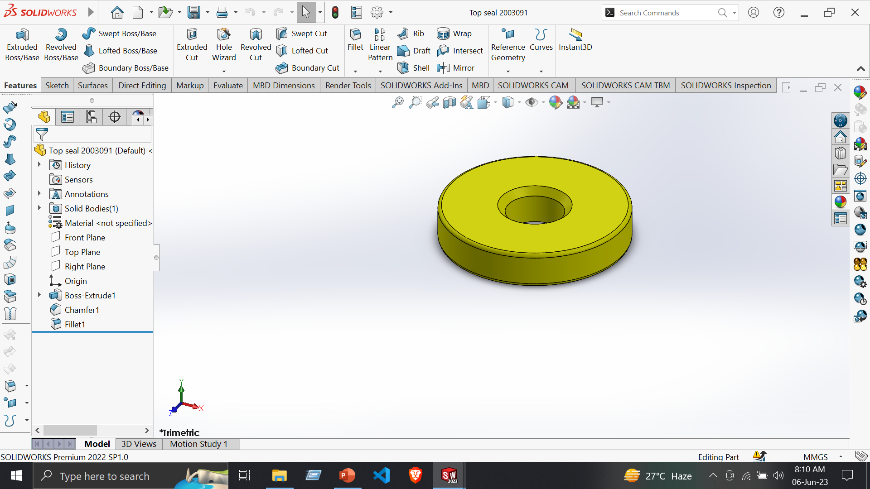
Part 4 : Top Seal
Tools:
Line
Centerline
Circle
Smart Dimensions
Features:
Extruded Boss/Base
Chamfer

Slide 20
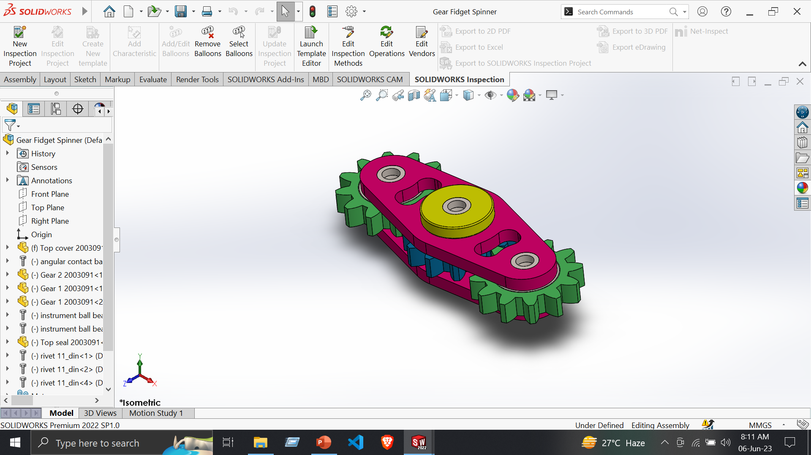
Assembly : Gear Fidget Spinner
Assembly –
Insert Component
Coincide Mate
Mechanical mate
Design Library
Angular Contact Ball Bearing
Concentric Mate

Slide 21
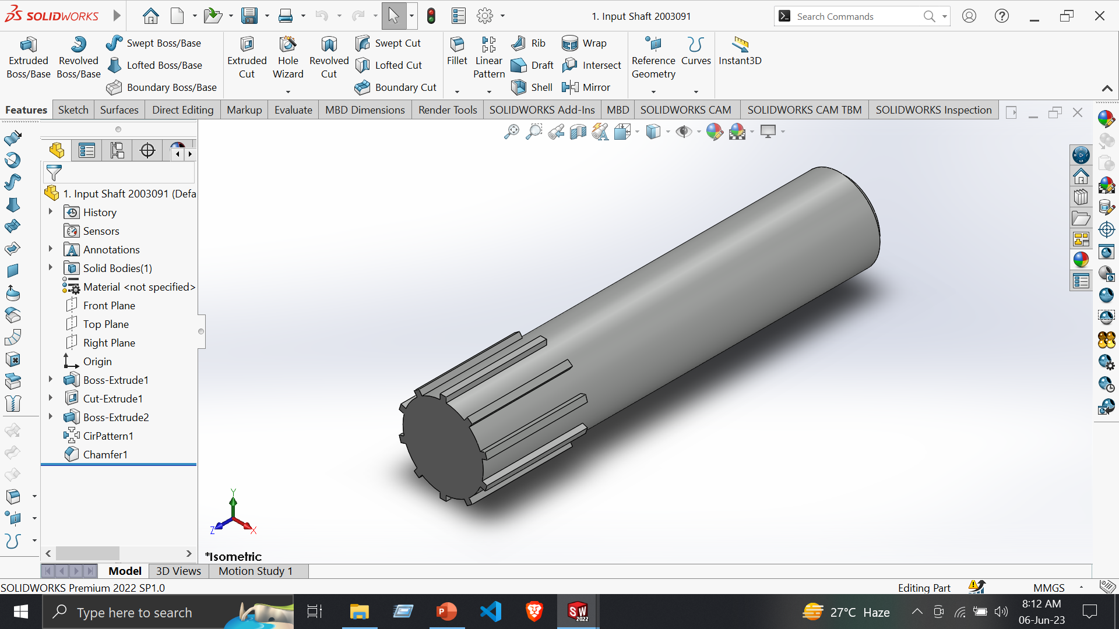
Part 1: Input Shaft
Tools:
Line
Centerline
Circle
Smart Dimensions
Features:
Extruded Boss/Base
Circular Pattern

Slide 22
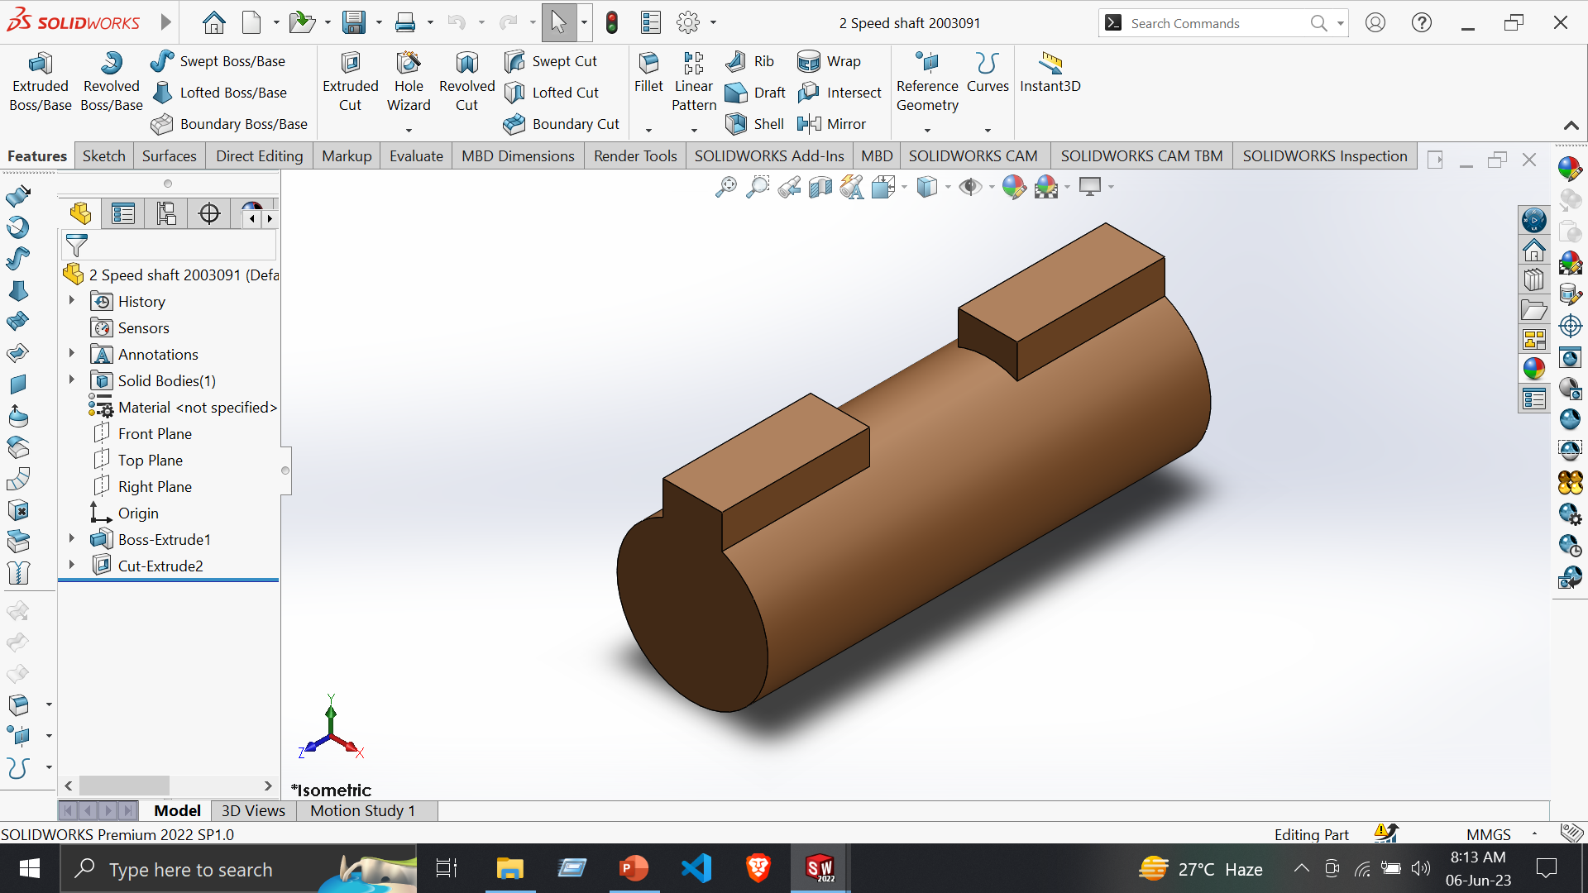
Part 2 : Speed Shaft
Tools:
Line
Centerline
Circle
Trim Entities
Smart Dimensions
Features:
Extruded Boss/Base
Extruded Cut

Slide 23
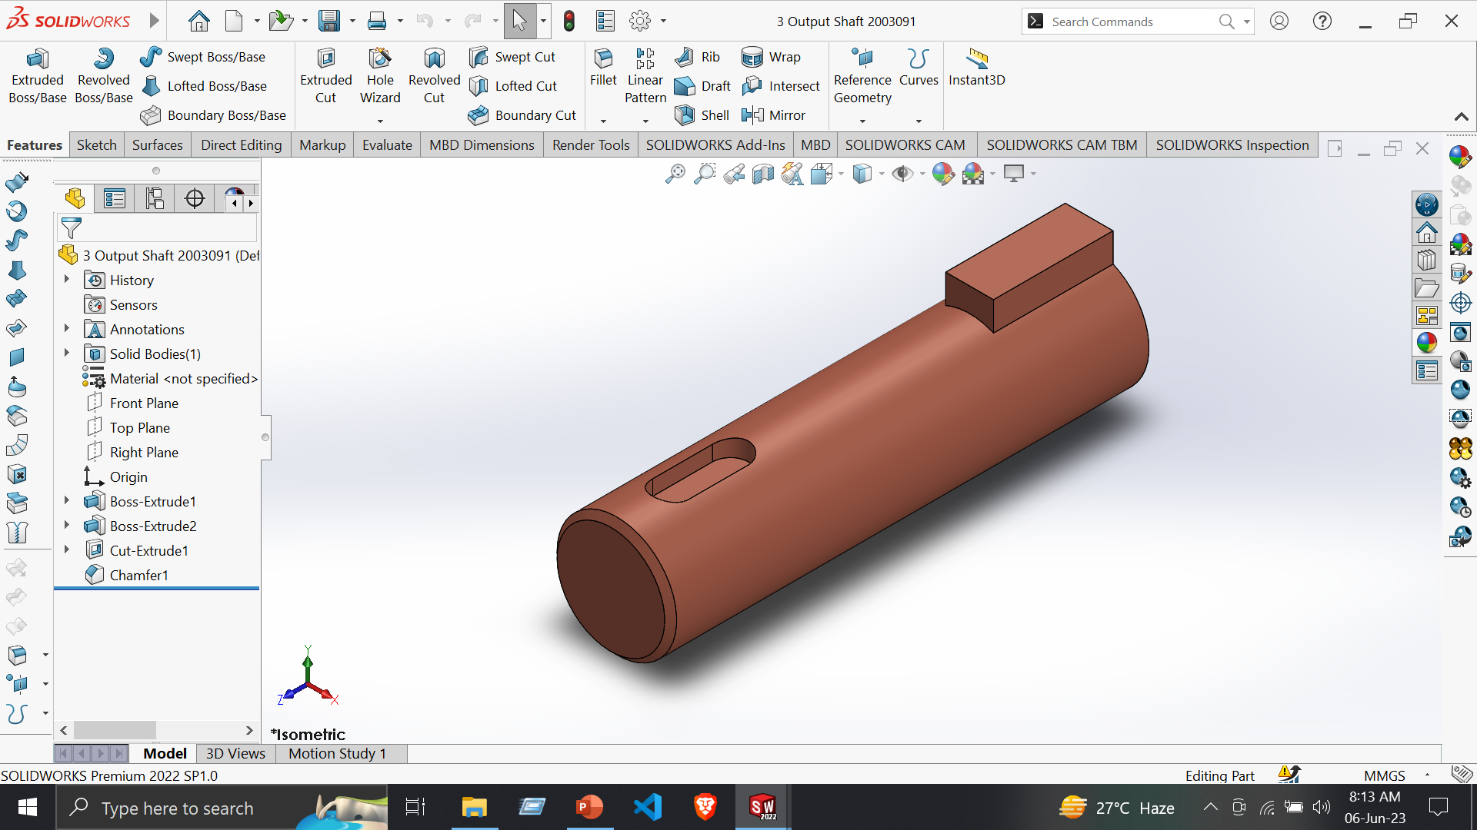
Part 3: Output Shaft
Tools:
Line
Centerline
Circle
Trim Entities
Smart Dimensions
Features:
Extruded Boss/Base
Extruded Cut
Chamfer

Slide 24
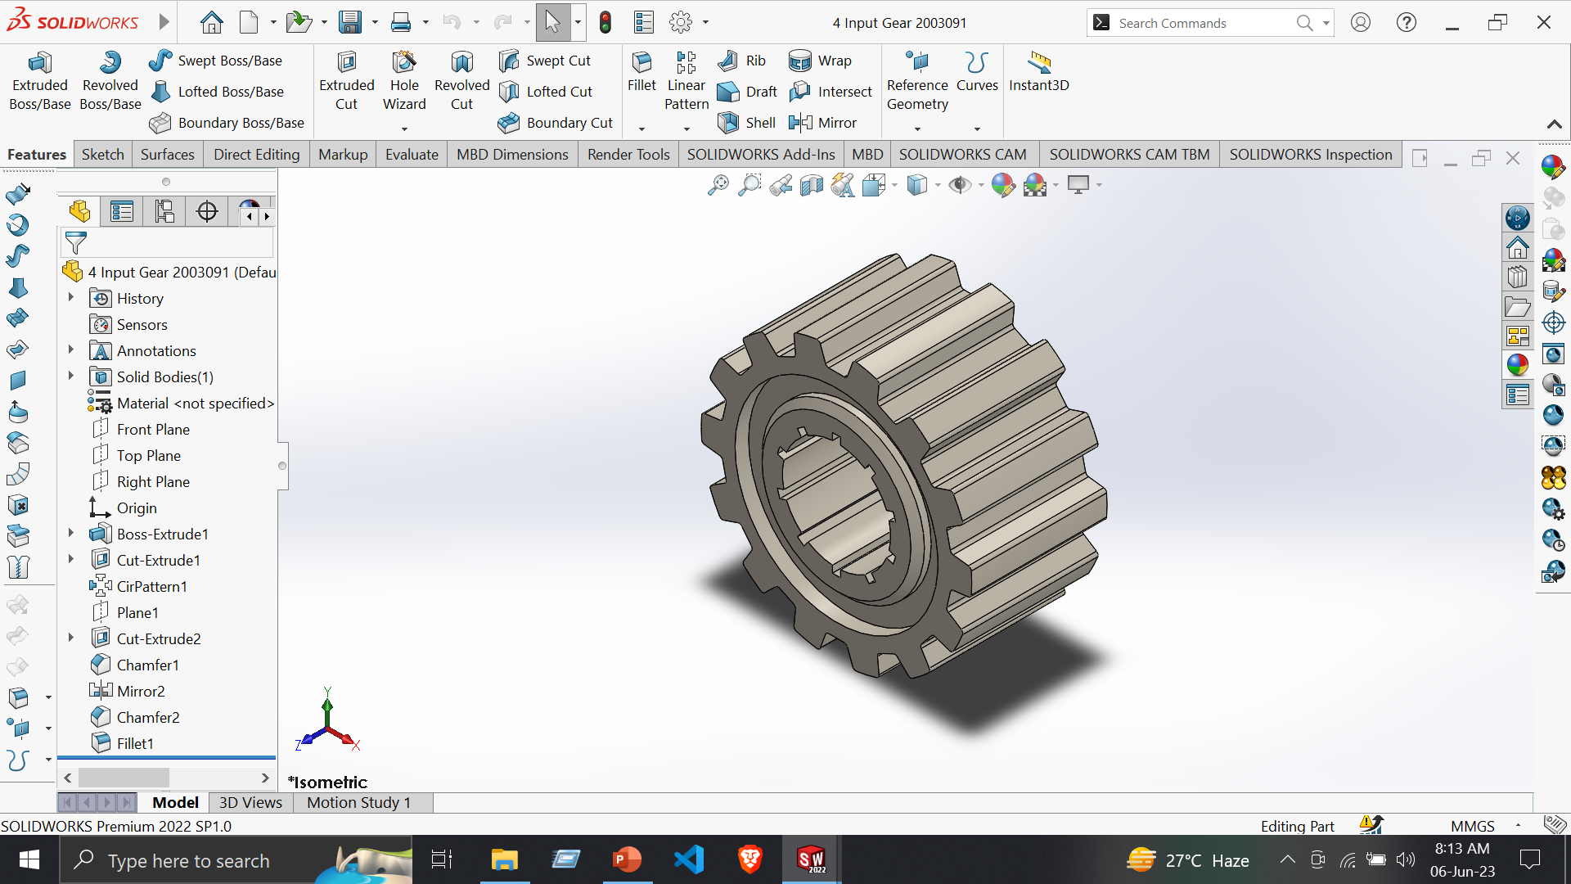
Part 4: Input Gear
Tools:
Line
Centerline
Circle
Trim Entities
Smart Dimensions
Features:
Extruded Boss/Base
Circular Pattern
Extruded Cut
Fillet

Slide 25
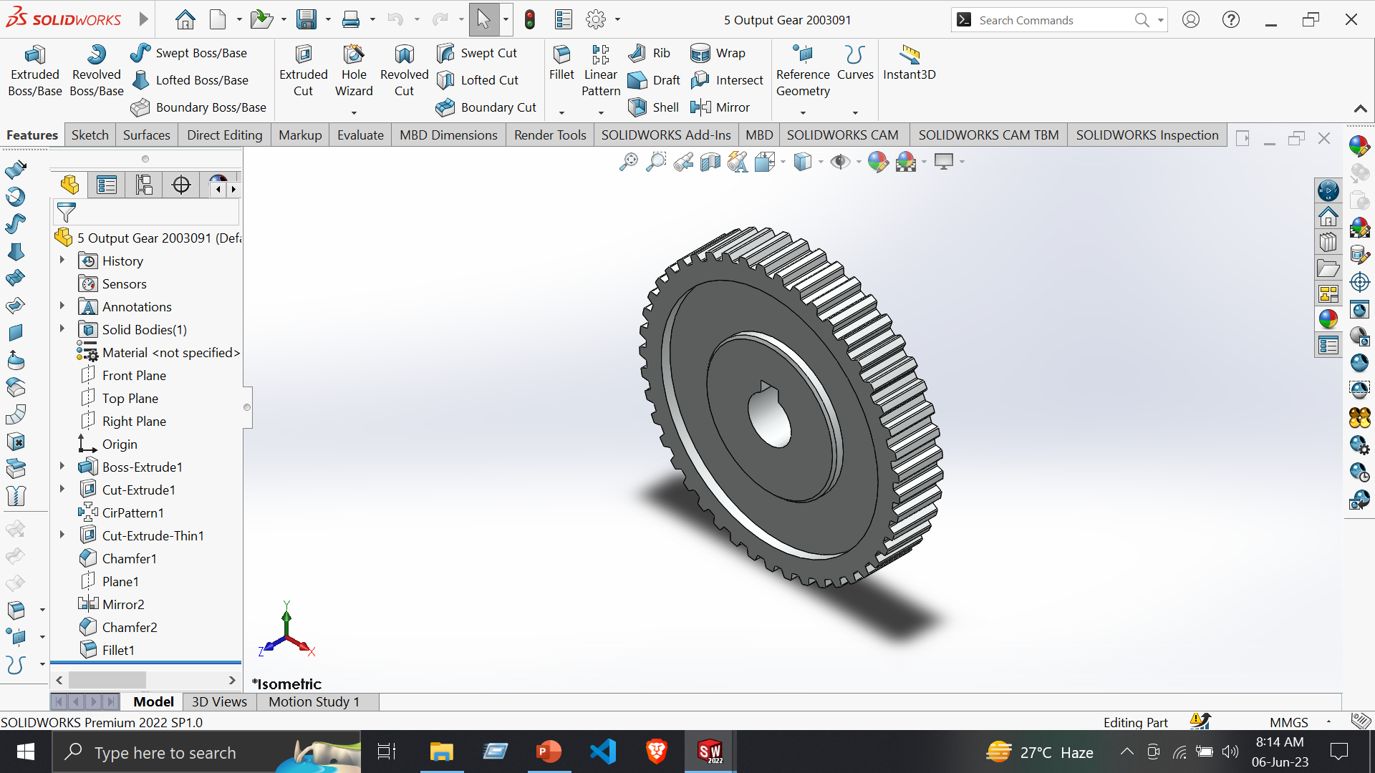
Part 5: Output Gear
Tools:
Line
Centerline
Circle
Trim Entities
Smart Dimensions
Features:
Extruded Boss/Base
Circular Pattern
Extruded Cut
Fillet

Slide 26
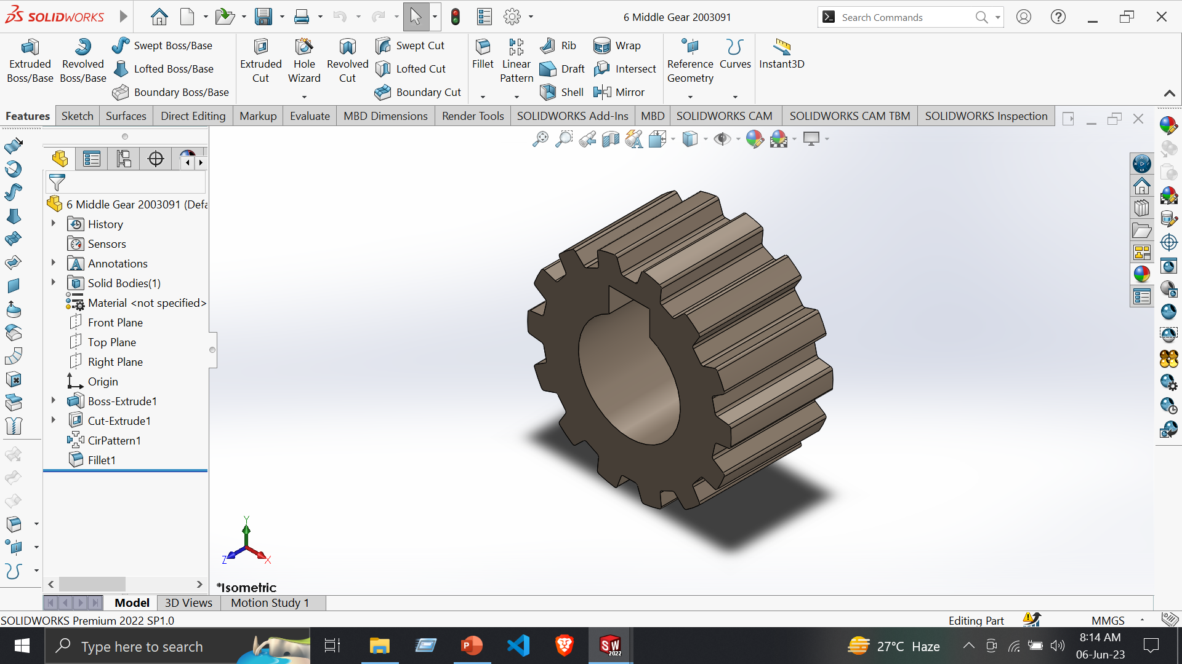
Part 6: Middle Gear
Tools:
Line
Centerline
Circle
Trim Entities
Smart Dimensions
Features:
Extruded Boss/Base
Circular Pattern
Extruded Cut
Fillet

Slide 27
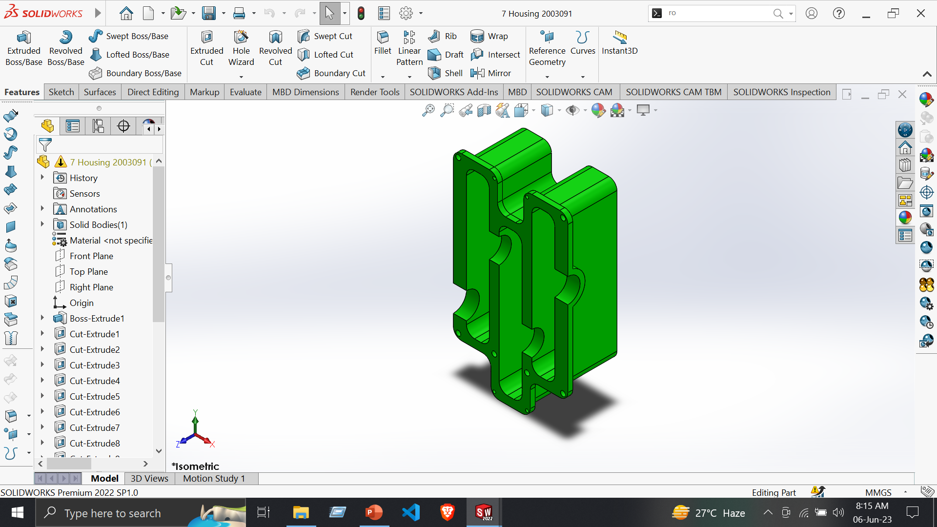
Part 7: Housing
Tools:
Line
Centerline
Circle
Trim Entities
Smart Dimensions
Features:
Extruded Boss/Base
Circular Pattern
Extruded Cut
Fillet

Slide 28
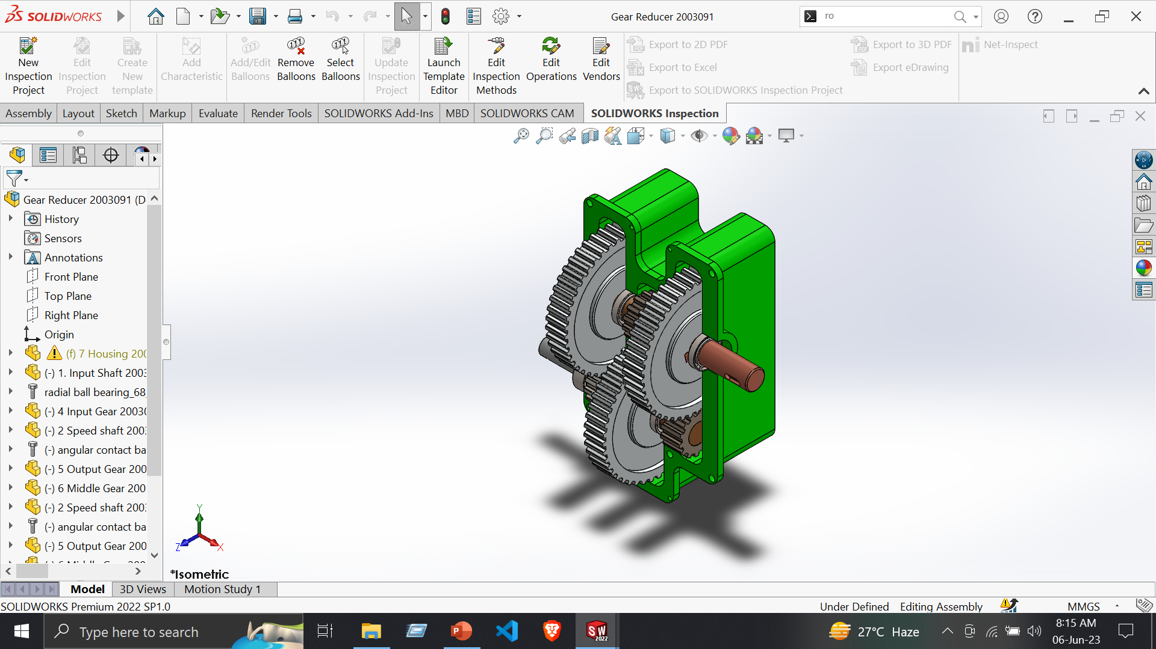
Assembly: Gear Reducer
Assembly –
Insert Component
Coincide Mate
Mechanical mate
Design Library
Angular Contact Ball Bearing
Radial Ball Bearing
Concentric Mate

